Slide 1
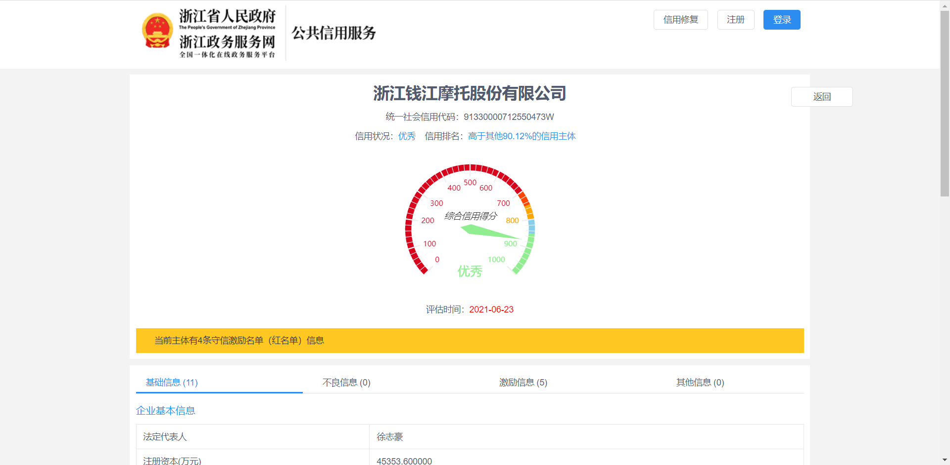
WHAT IS WEBSITE?
Website = UI + DATA
Data
Image UI
DashBoard UI
Table UI
Data
Data

Slide 2
WHAT IS WEBSITE?
Website = UI + DATA
UI → *.html file
Data → *.xml/*.json file
Both UIs and data are files
*.html
*.json
Browser
Rendering

Slide 3
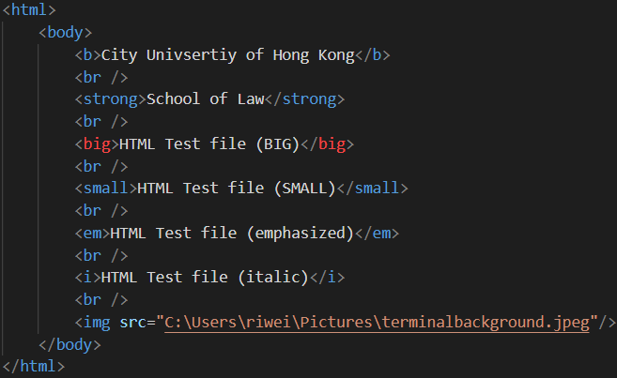
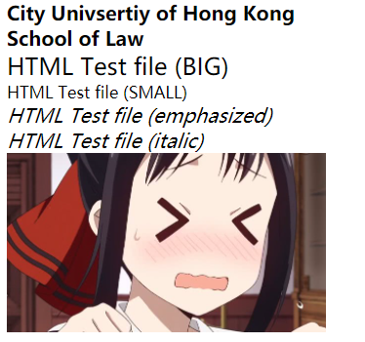
Html files -- DRAWING UI
HTML: Hyper Text Markup Language
HTML Example
After Browser rendering

Slide 4
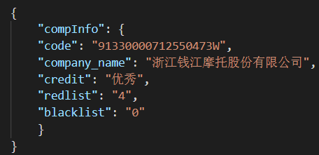
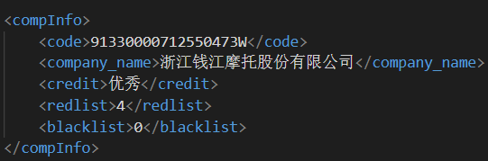
JSON/XML files – STORING DATA
Data given in the table format:
Code | CompanyName | Credit | RedList | BlackList
91330000712550473W | 浙江钱江摩托股份有限公司 | 优秀 | 4 | 0
XML Example
JSON Example

Slide 5
Internet communication
Hypertext Transfer Protocol(HTTP): Request / Response Protocol Between clients and servers
Request: Client (User) send a request (such as Unified Code in Zhejiang) to remote servers
Response: Server will send back a response (*.html and *.json)

Slide 6
Crawler-1 observation
Website: UI + Data → We are interested in the data.
Find the HTTP responses of data!
Normal Approach: Send a request to remote servers and parse the response from servers.
Composition of Request and Response in HTTP:
Request = Header + Parameters
Response = Header + Results
Header: It records the address of remote servers, most HTTP requests have similar header structure.
Parameter/Result: User-defined Information
Header
Parameters
Header
Results
HTTP Request Structure
HTTP Response Structure

Slide 7
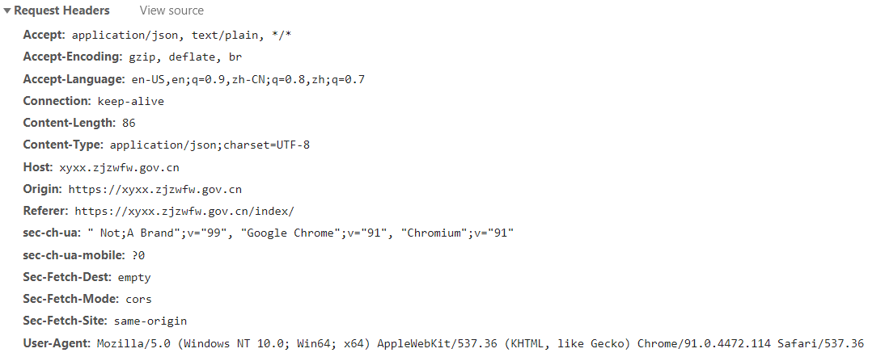
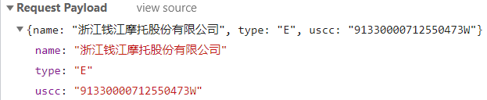
Crawler-1 observation
Example of Request:. Create a HTTP request to Zhejiang Credit System
Request Parameters
Header Information

Slide 8
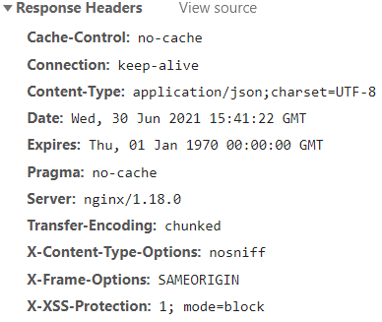
Crawler-1 observation
Example of Response:. Get a HTTP response from Zhejiang Credit System
Response Results (Json Format)
Header Information

Slide 9
Crawler-1 observation
How to check These Information: Check Chrome Inspection Function!
Steps:
Right Click in the browser
Click “Inspect”
Click “Network” in the popping window
Refresh the website and then the browser will show all requests about the website.
Check each requests’ response and see if they contains target data.
If we find the target response, we should markdown the request information, and employ python to send request to server.

Slide 10
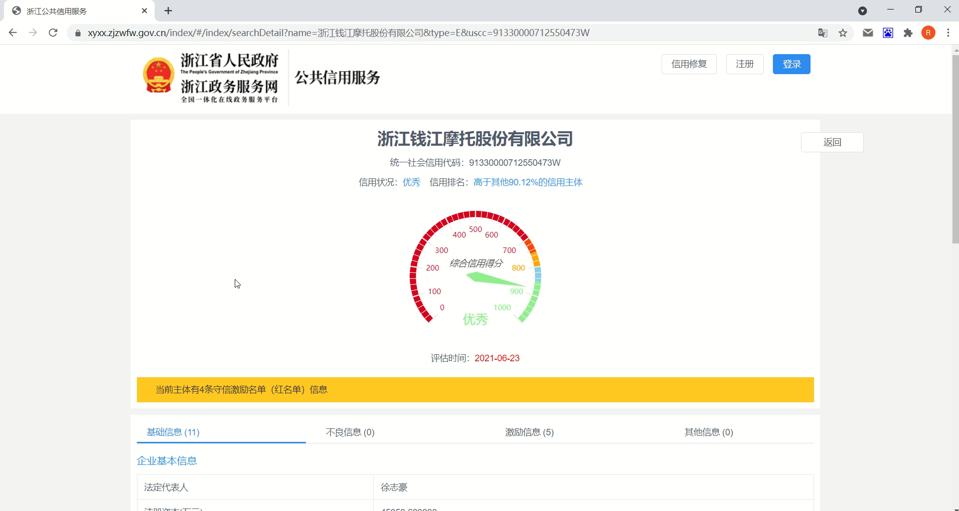
Crawler-1 observation
Click and Play the Video 👉

Slide 11
Crawler-2 DESIGN
How to Get the Response Automatically: Write a program to send requests to servers.
Step 1: Problem Statement
We only have social credit codes → How to get the detailed information of each company.
Step 2: Find the Expected Response
Firstly, we need to find which response contains our expected information. → Use Chrome Inspection Function!

Slide 12
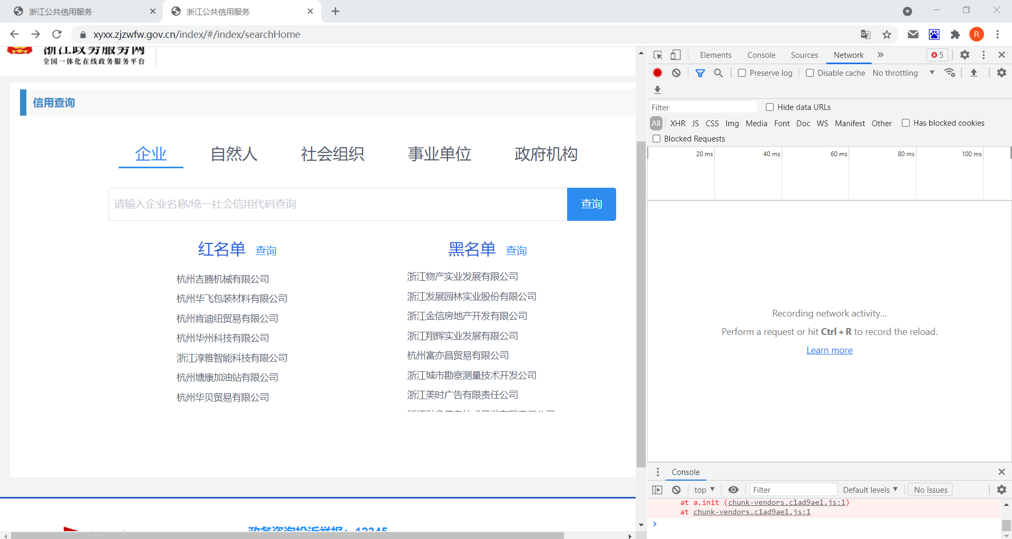
Crawler-2 DESIGN
We can firstly go to the Zhejiang Search Service Website and open the inspection window. Then go to the Network tab as shown below:

Slide 13
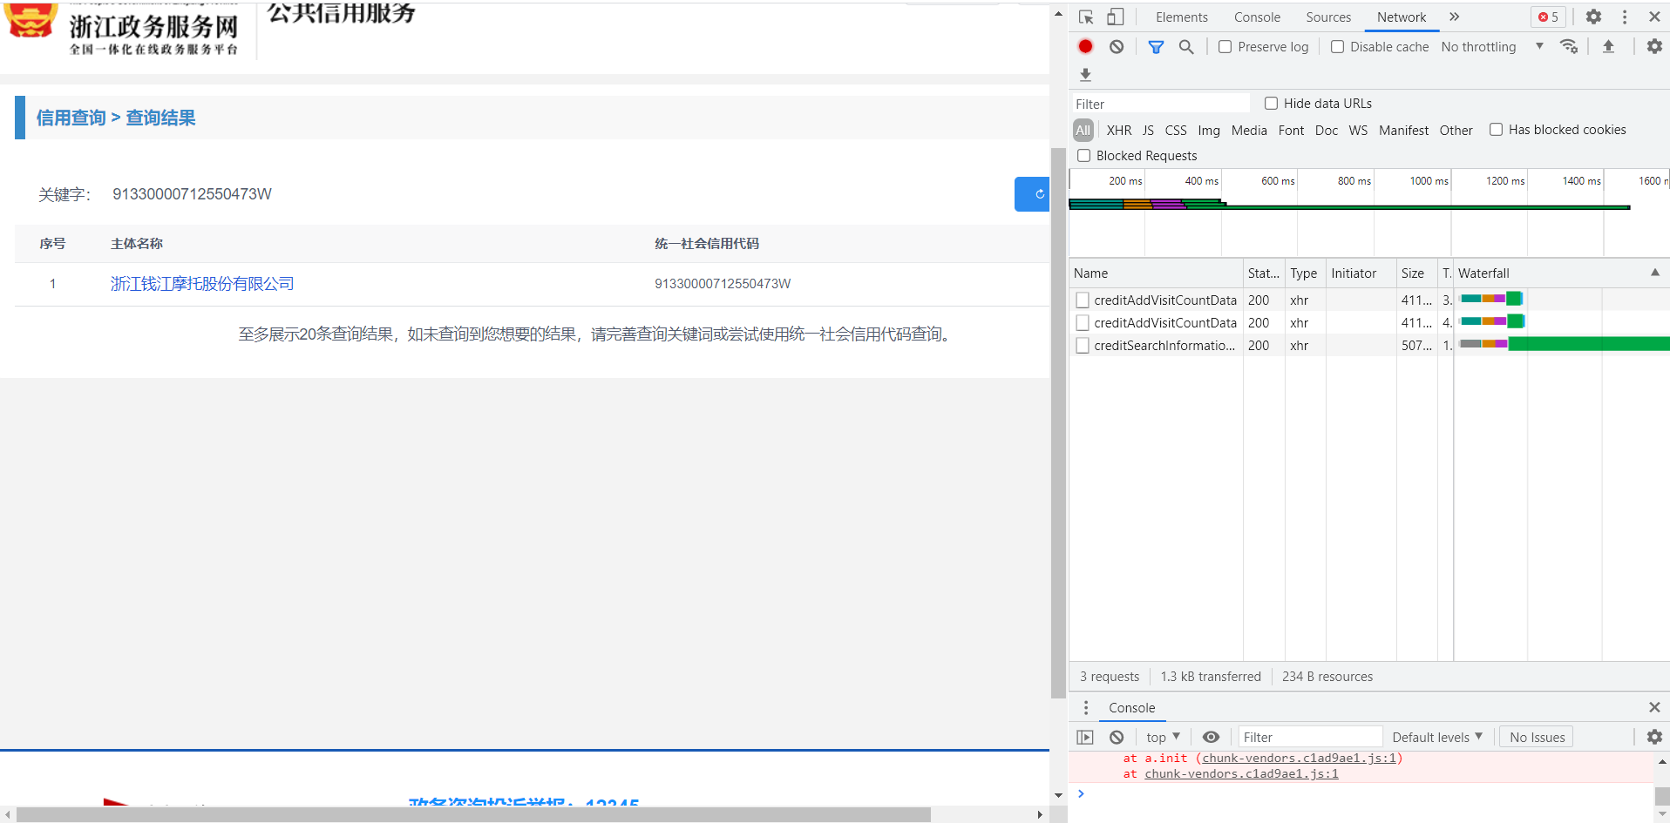
Crawler-2 DESIGN
Input a credit code and right-click “查询 Inspect”. Pay attention to the information on the inspection window:
→ There are 3 requests on the inspection window: Check which request can obtain the company name “浙江钱江摩托股份有限公司”.

Slide 14
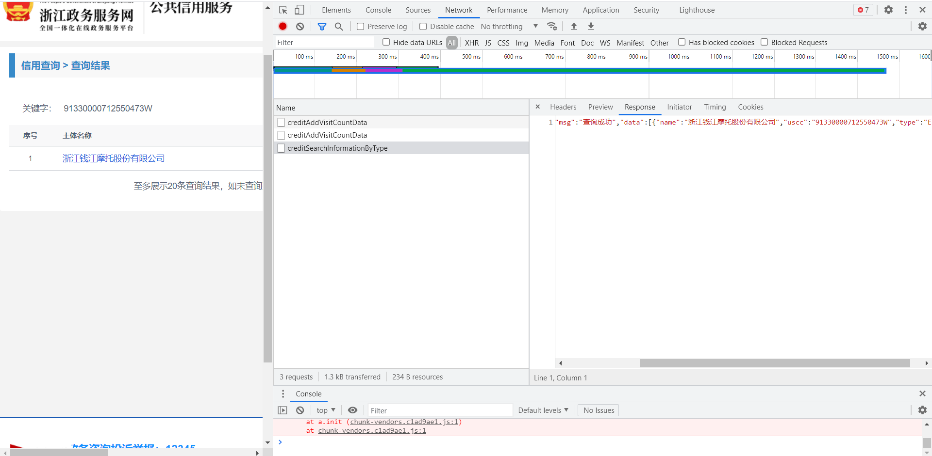
Crawler-2 DESIGN
The third request contains our expected information “浙江钱江摩托股份有限公司”. Click the third request and get more detailed request information.

Slide 15
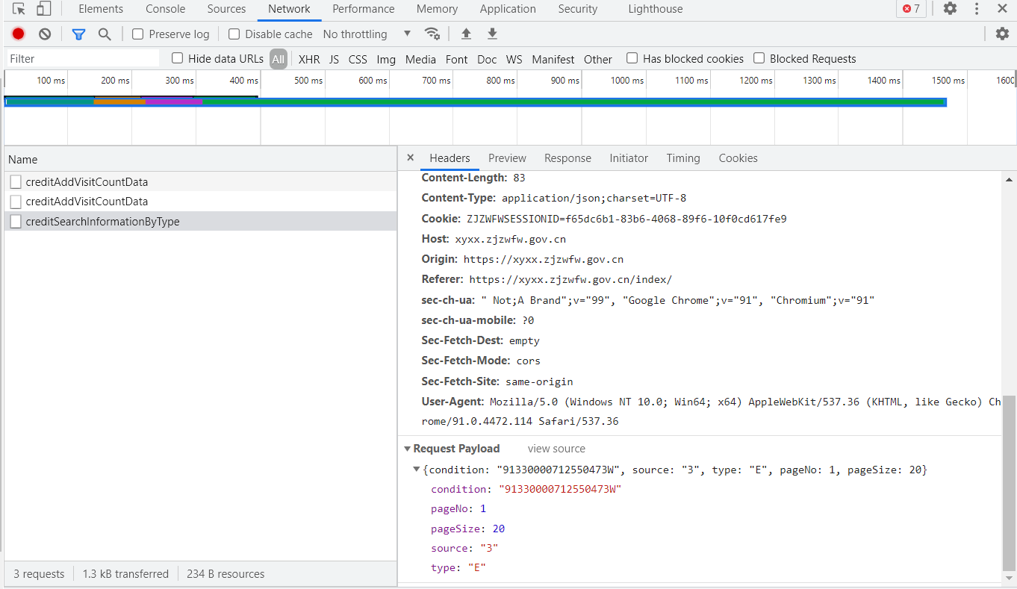
Crawler-2 DESIGN
Then, mark down the request name “creditSearchInformationByType”, and header and parameters on the inspection window. They will be used in python program.

Slide 16
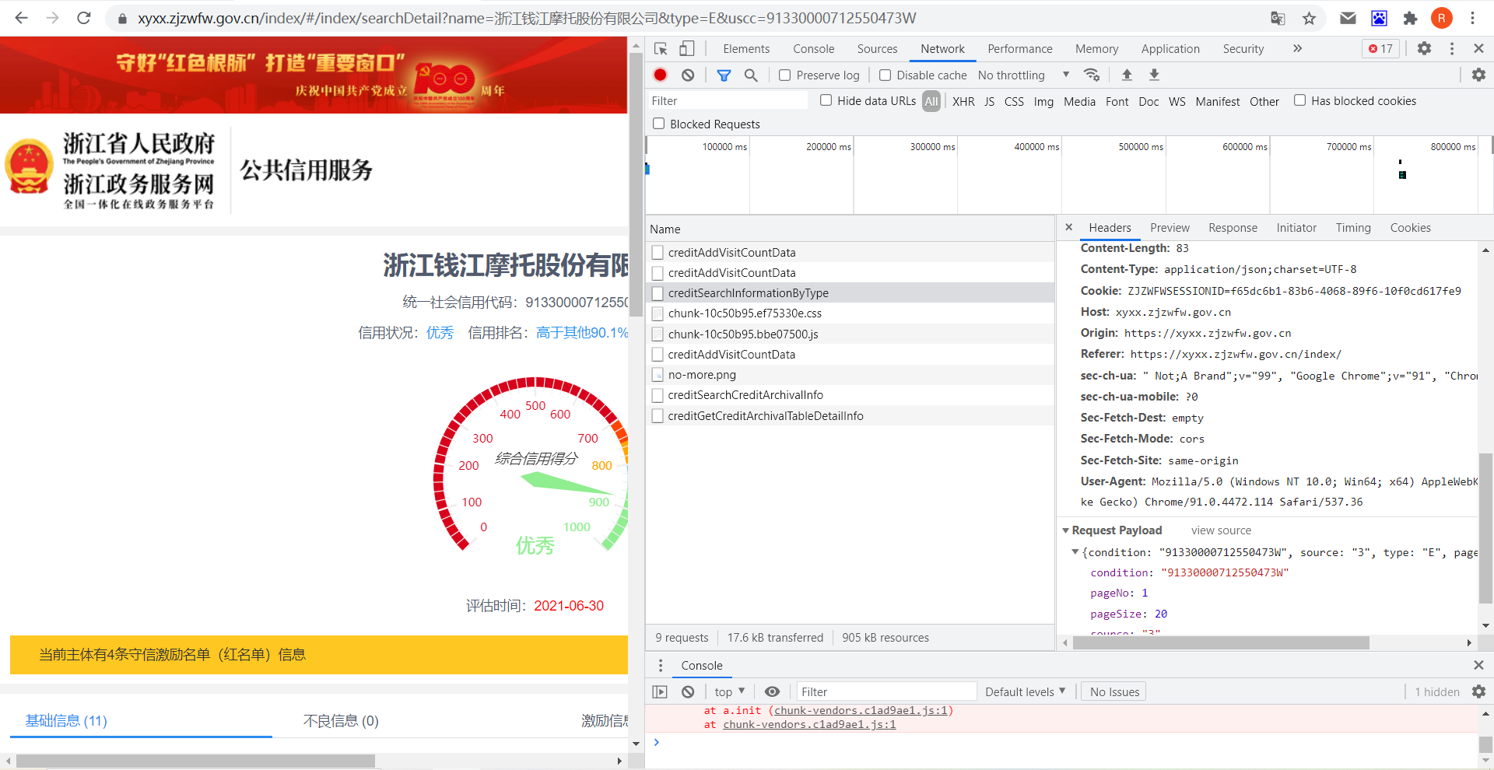
Crawler-2 design
Step 3: Find the request including the detailed information
In last step, we get the name by credit code, but still cannot obtain the detailed information of “浙江钱江摩托股份有限公司”because the website doesn’t contain the detailed part.
We should click the “浙江钱江摩托股份有限公司” link and go into the website containing detailed information.
Reminder: Keep observing the inspection window. We can see that some new requests are sent to servers.

Slide 17
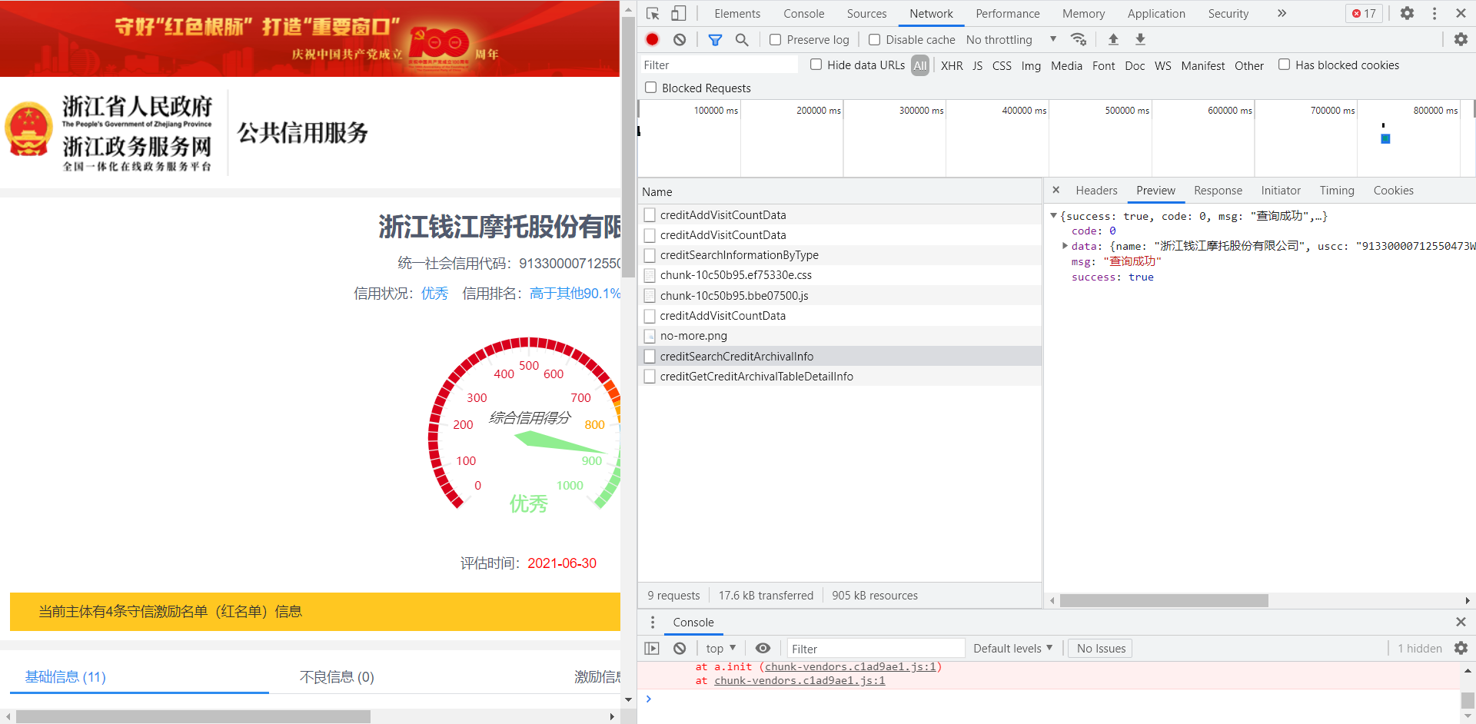
Crawler-2 design
We can see that some new requests are sent to servers. Like Step 2, find the request including the expected information. Then, we find that the penultimate request matches our expectation.

Slide 18
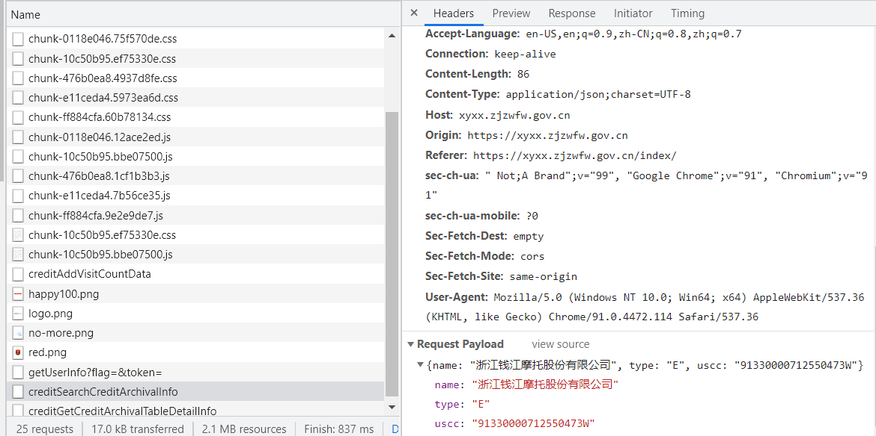
Crawler-2 design
Then we should Analyze the Request Parameters and Response:
It consists of three parameters: “name”, “type”, “uscc”.
“uscc” is the credit code of company → We get it.
“type” always equals to “E” by observation.
“name” is obtained by Step 2.
We have request parameters → We can the response (detailed information)!

Slide 19
Crawler-2 design
Mark down the request name “creditSearchCreditArchivalInfo”, header, and parameters.

Slide 20
Crawler-2 design
Step 4: Conclude the process
Given a social credit code
Send a Request to get name
Send name and code to get detailed info
Automatically Process By Python

